Slide 1

Writing & Rhetoric

Slide 2

What do you think?
Why do we write?
What is the purpose of writing?
Why are writing skills important?
Why do we write essays?
Is there a difference between a writer and an author? Are you either one?
What is Rhetoric?

Slide 3

Author’s Purpose
Communicate
Human beings have the need to communicate and express ourselves.
History – symbols; cave paintings; codes to communicate.
Creation of language and a system of communication
Evolution of communication: language, images, and graphics.
Our goal has always been: How can we get our message across? Quicker? Widely?
Personal / Ourselves
We write for ourselves: To think, learn and understand. Writing for ourselves is a private affair though it may be shared with others.
Entertain, Inform, Persuade others
When we write for others, the purpose is to: inform, entertain, or persuade (or a combination).
Usually for assessment or publication for a wide range of readers.
To tell your story; Share your perspective; communicate your insight that is uniquely your own.

Slide 4

Writing Skills & Essays
It is important to hone our writing skills so that we can communicate effectively.
Communicate our point clearly
Avoid misinterpretation
Display credibility
Academic Essays for Learning: Essay are a form of using various techniques to enhance our learning. It is an effective way of expressing our thoughts, ideas, and learning.

Slide 5
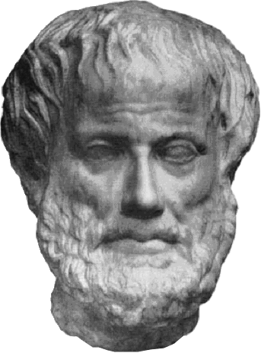
Rhetoric – What is it?
If we want to write effectively, we must practice and master the use of rhetoric.
Rhetoric – The art of using language effectively (in writing or speaking) to persuade your reader of your point.
Rhetoric helps your build your communication style. Helps you make your writing meaningful and powerful.
As language evolved, so did our need to understand, use, and interpret it. We had to organize language in ways that were meaningful. Aristotle said, language can be used for “good or ill.” It can be used to provide information to help or mislead. This is true today – and the need for understanding rhetoric is crucial today.

Slide 6
Rhetorical Situation
All communication (speaking, writing, behavior) is rhetorical. We all want to get our point across.
Before deciding how you will use rhetoric in writing or speaking, you must first assess the rhetorical situation.
Rhetorical Situation: The circumstances or the environment in which the action (writing or speaking) is taking place. Some examples are: The classroom, debates, friend groups, lectures, speeches.
To assess the rhetorical situation, listen and observe: Who is the audience? What do they know? What do they care about? What and how do I get my point across to them?
We think rhetorically even though we are not always aware of it.
When we think rhetorically, we are able to make more informed decisions about what we think and feel about an idea. We can then, express our ideas in an informed way.
Writing has evolved over time. Today, we are writing in a variety of mediums, written and visual.

Slide 7
Rhetorical Situation
The rhetorical situation consists of:
Audience: Who is listening or reading? What is my relationship with them?
Purpose: Do I want to inform, entertain, or persuade my audience?
Genre: How do I want to present my message (essay, letter, report)?
Stance: What tone do I want to take with my message (assertive, calm)?
Context: What are the issues or circumstances surrounding your message (constraints)?
Medium & Design: What medium and design should I use in the delivery of my message?

Slide 8
Questions?

